Slide 1
RDM Remote Data Management
RDM from a user perspective at field test GTT
Tomas Ågren, Field test GTT

Slide 2
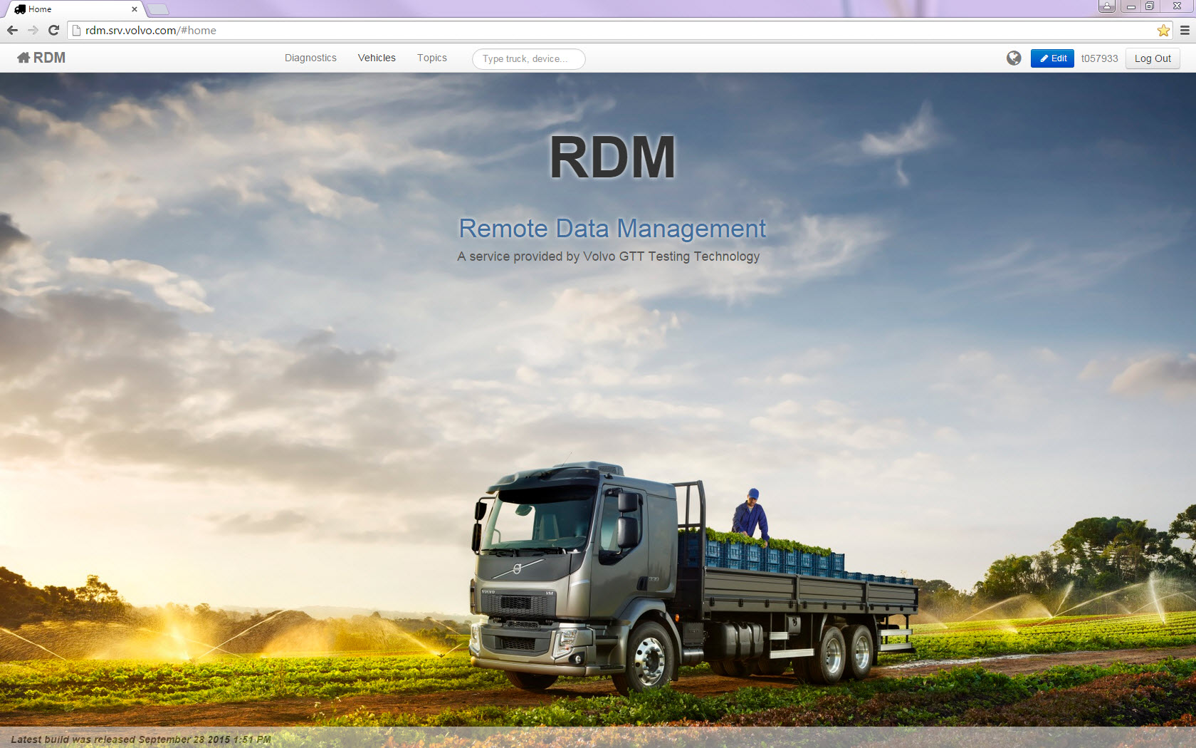
http://rdm.srv.volvo.com/ Logon with your user credentials
TTSupportGOT@volvo.com If support is needed regarding uptime

Slide 3
How we are using RDM in field test
Diagnostics (Never used by me and seems not to be updated)
Vehicle view
Topics (Questions, answers, feedback) Not updated with any topics latest months
Truck view
Details
Map
Information
Diagnostics
Area
DM (Diagnostics Messages broadcasting on BB1)
DTC (Diagnostic Trouble Codes)
Devices
Measurements
ECU list
Often used functions by me

Slide 4
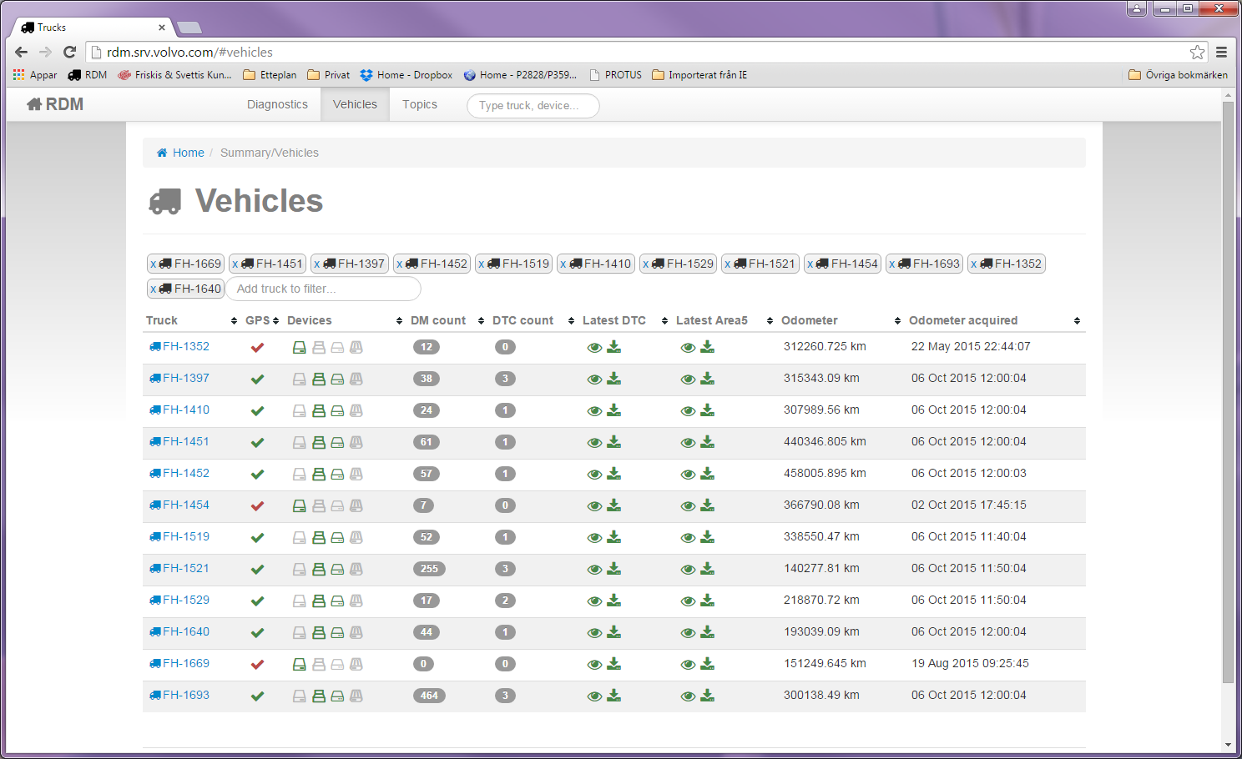
Vehicle view
GPS Position not received within the last 2 days
This view is filtered on the trucks which interests me most
Return

Slide 5
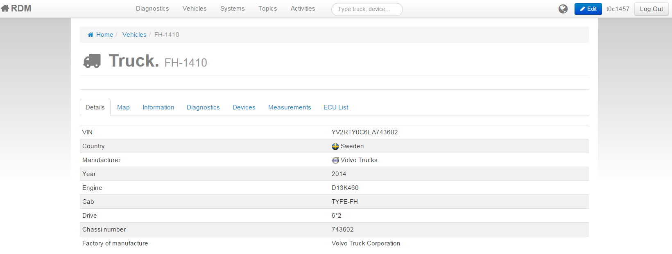
Truck view - Details
Return

Slide 6
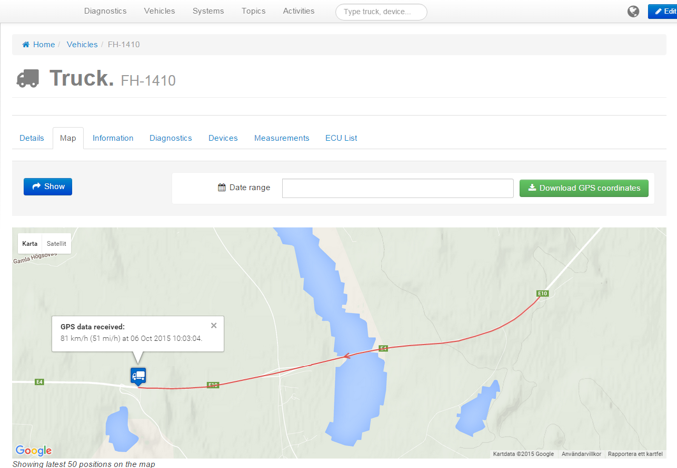
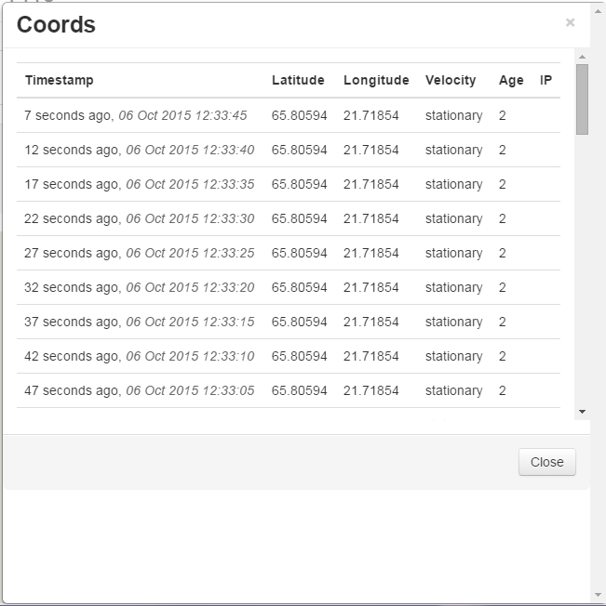
Truck view - Map
Pressing truck icon shows when latest GPS data was received
”Show” button shows 50 latest GPS points
”Download GPS coordinates” downloads historic GPS data
Return

Slide 7
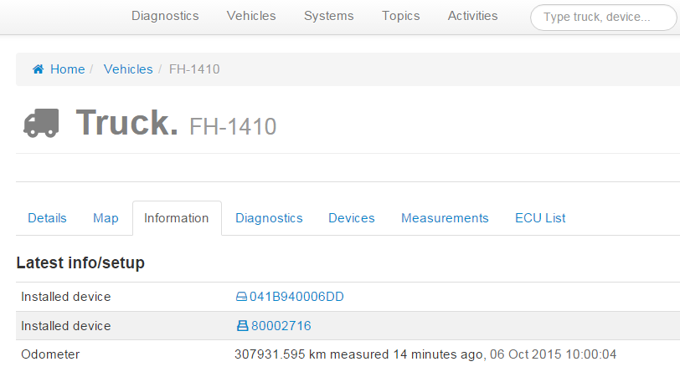
Truck view - Information
Return

Slide 8
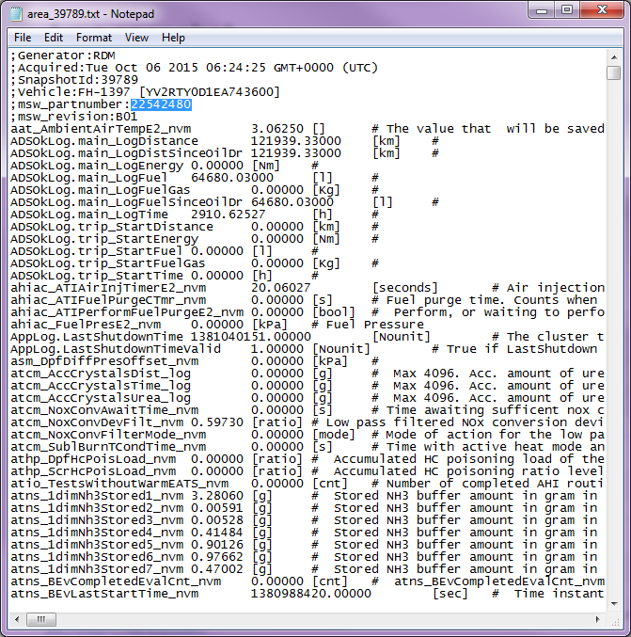
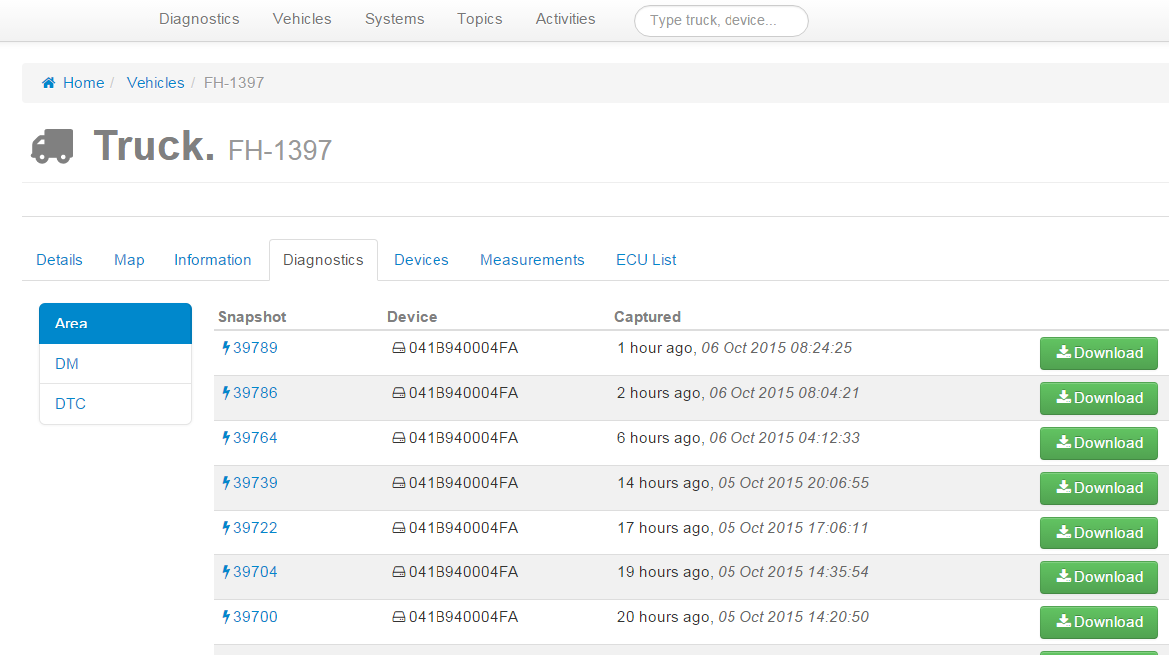
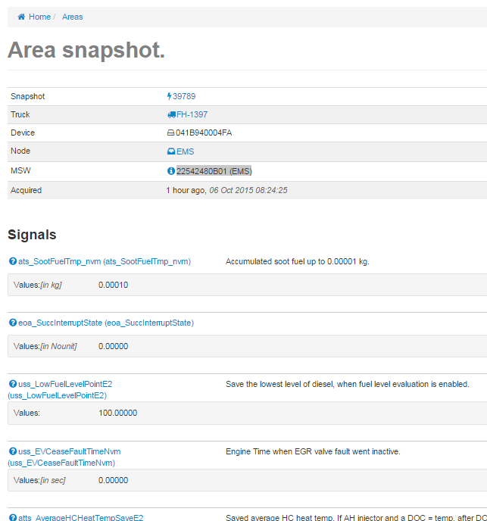
Truck view – Diagnostics – Area5
Always check that MSW number is correct!
Return

Slide 9
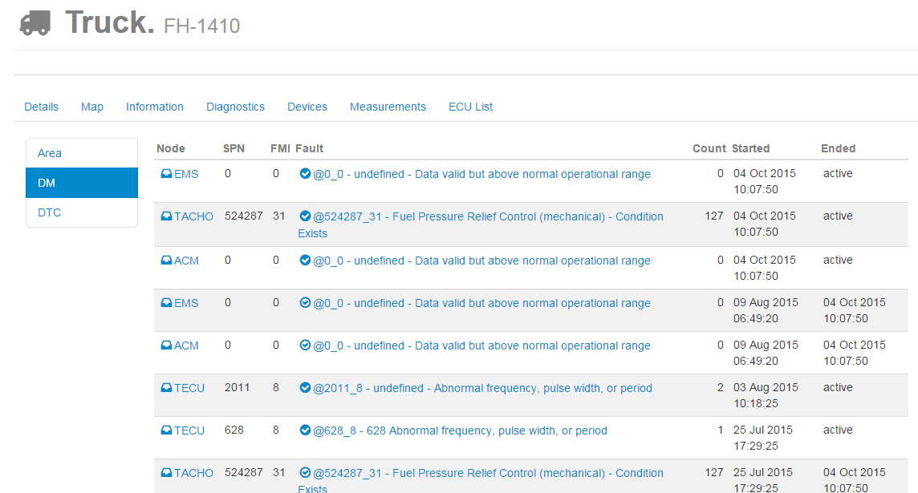
Truck view – Diagnostics – DM
Return

Slide 10
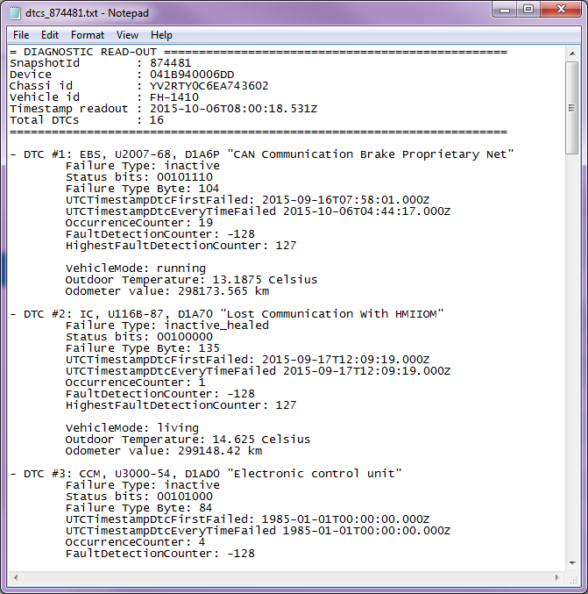
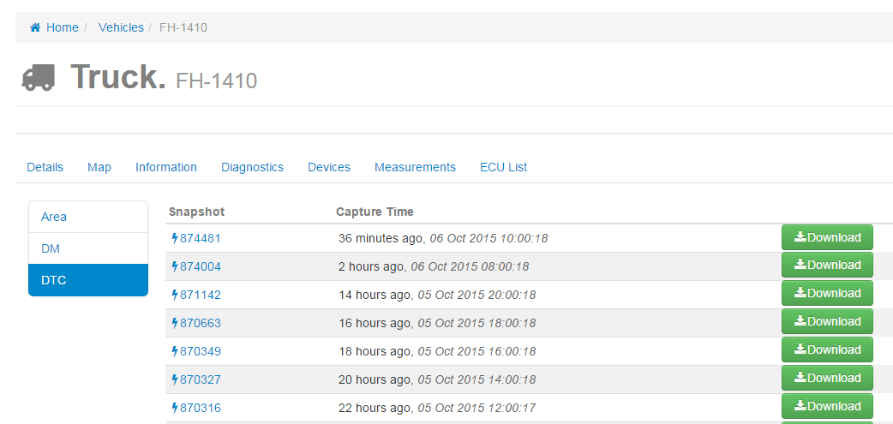
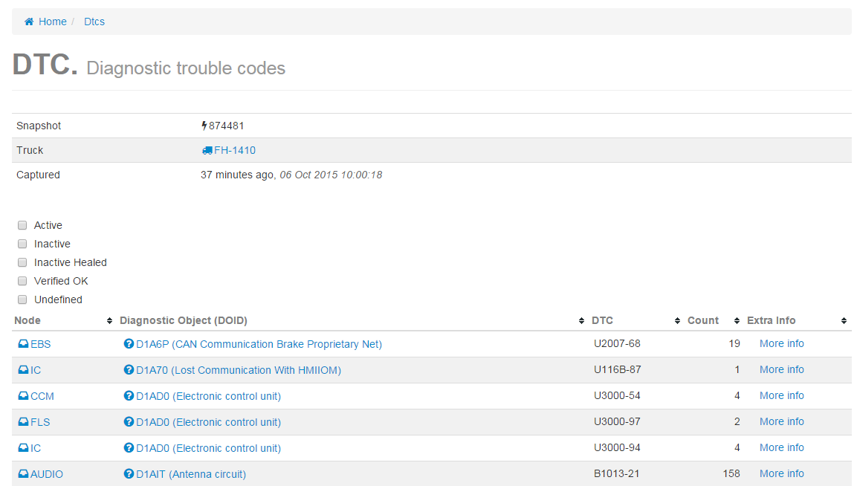
Truck view – Diagnostics – DTC
Can be filtered and most used filter for me is to check active DTC´s
Return

Slide 11
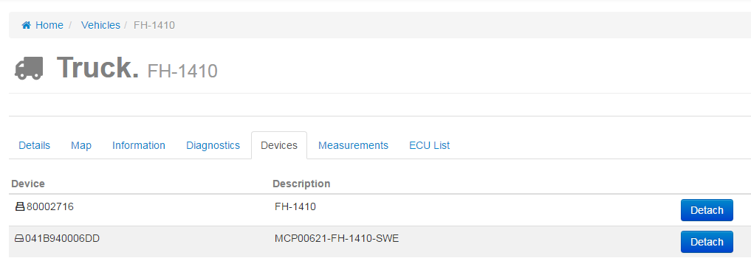
Truck view – Devices
Be aware and do not Detach the systems!!!
Return

Slide 12
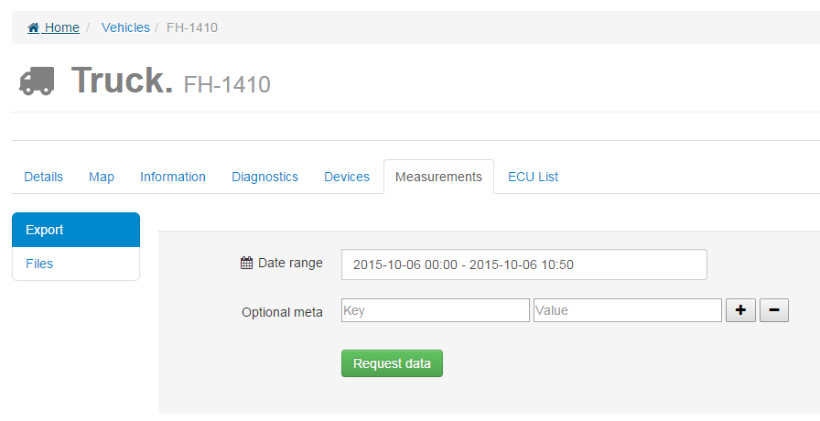
Truck view – Measurements
I have never used this function!
Return

Slide 13
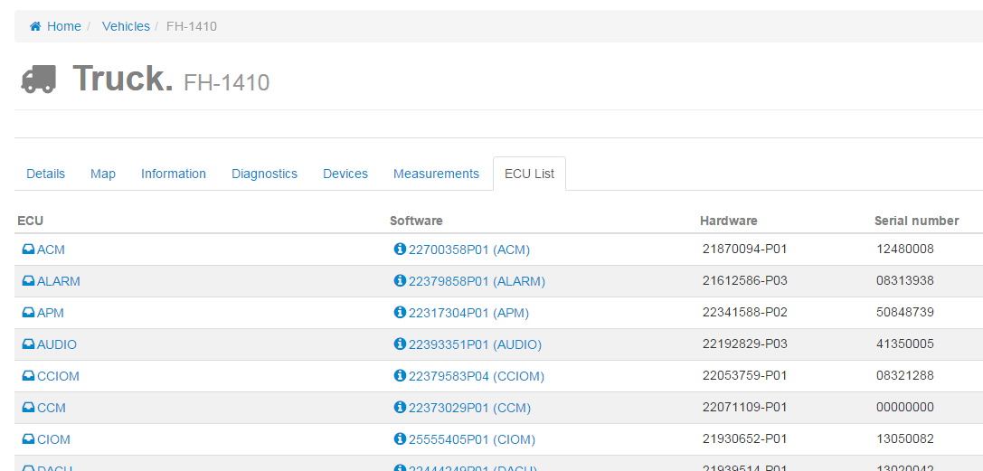
Truck view – ECU List
Complete ECU list with MSW, HW and snr
Return

